Slide 1
Comparing Covid-19 Dynamics In Rural and Urban Counties

Slide 2
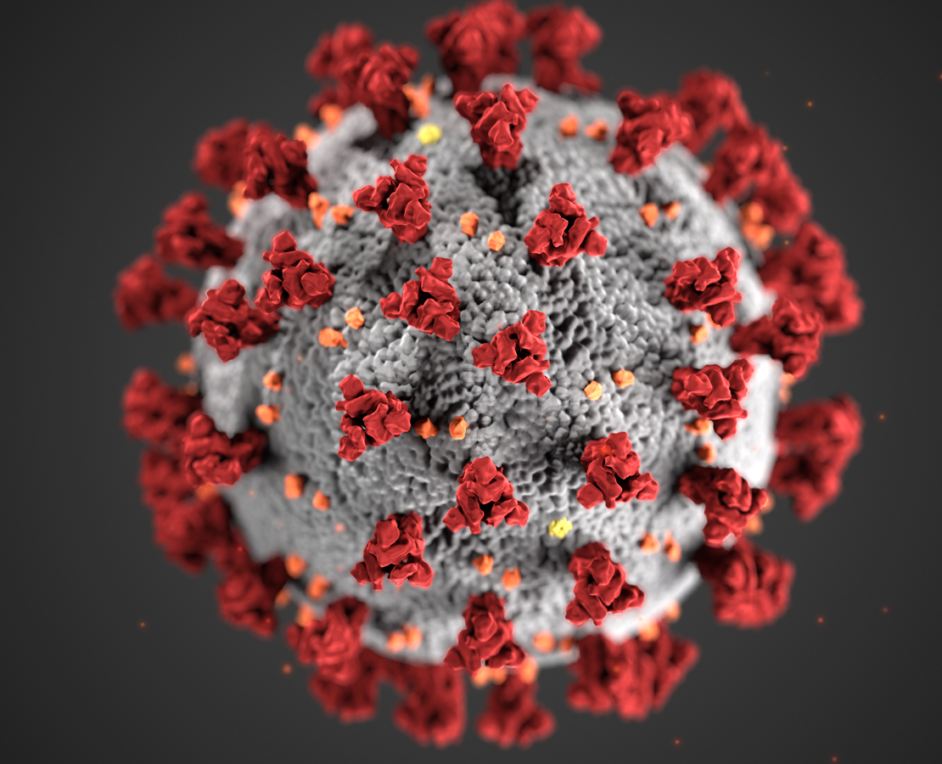
Fda.gov

Slide 3
Why is this important?
Lack of Data on Urban vs Rural Populations

Slide 4
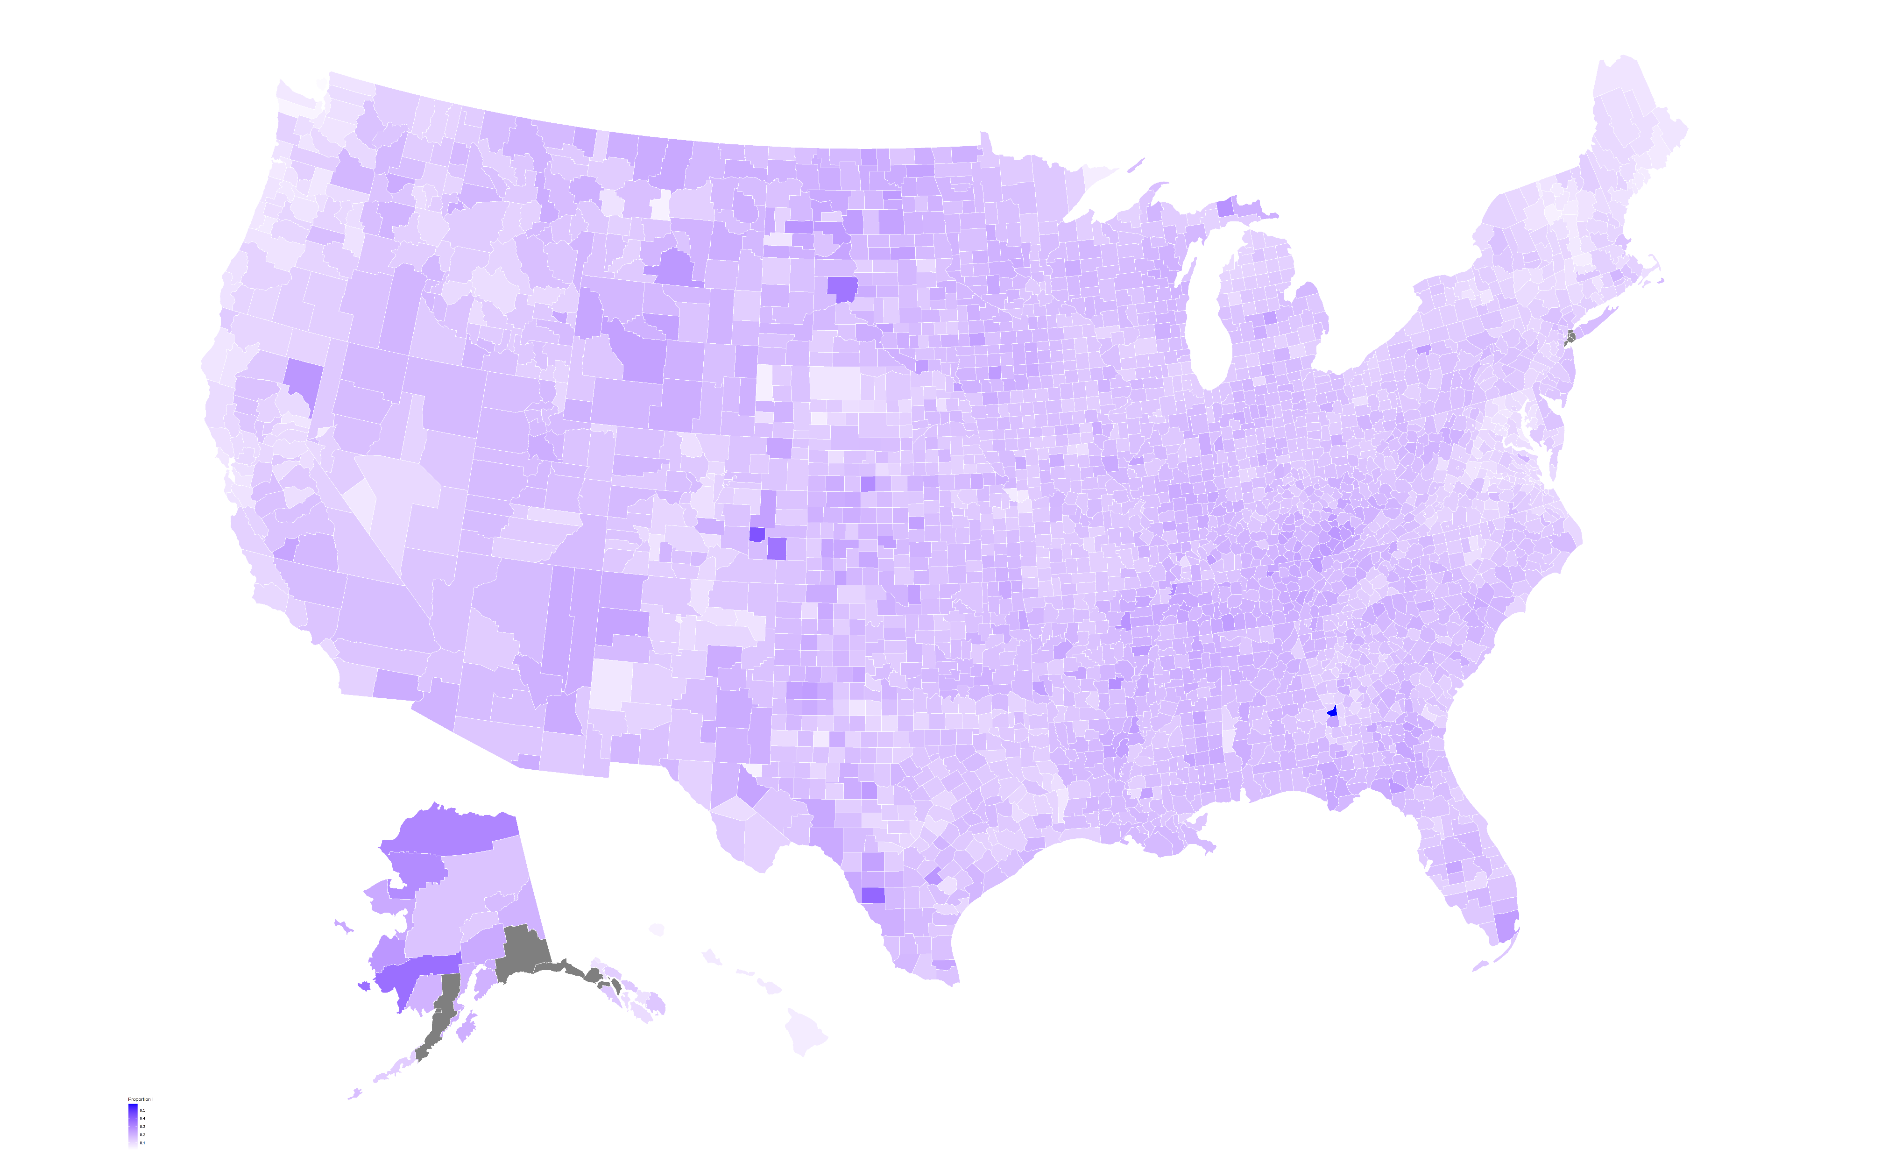
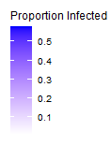

Slide 5
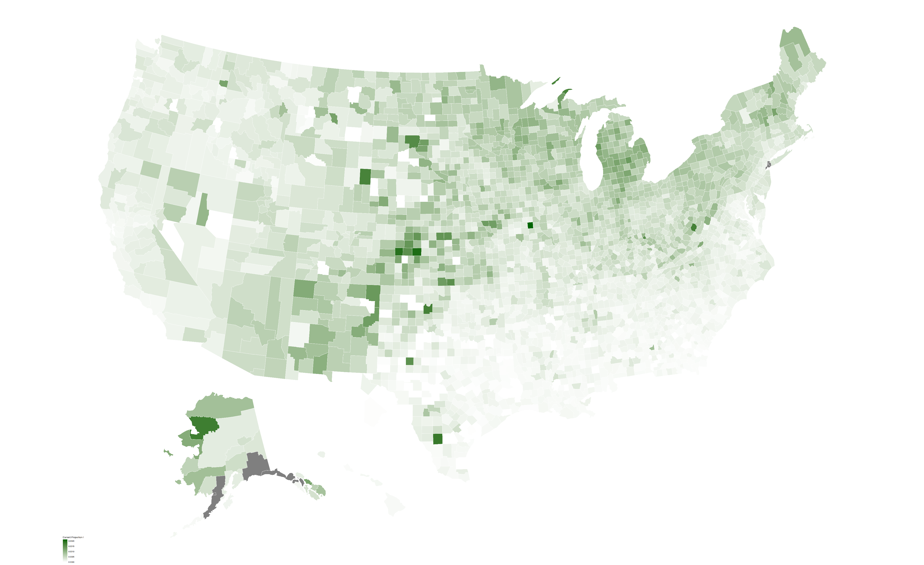
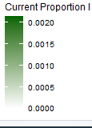

Slide 6


Urban Area:
Population ≥ 50,000
Rural:
Population < 2,500
Urban Area:
Population ≥ 50,000
Urban Cluster:
Population < 50,000
Population ≥ 2,500
Rural:
Population < 2,500

Slide 7
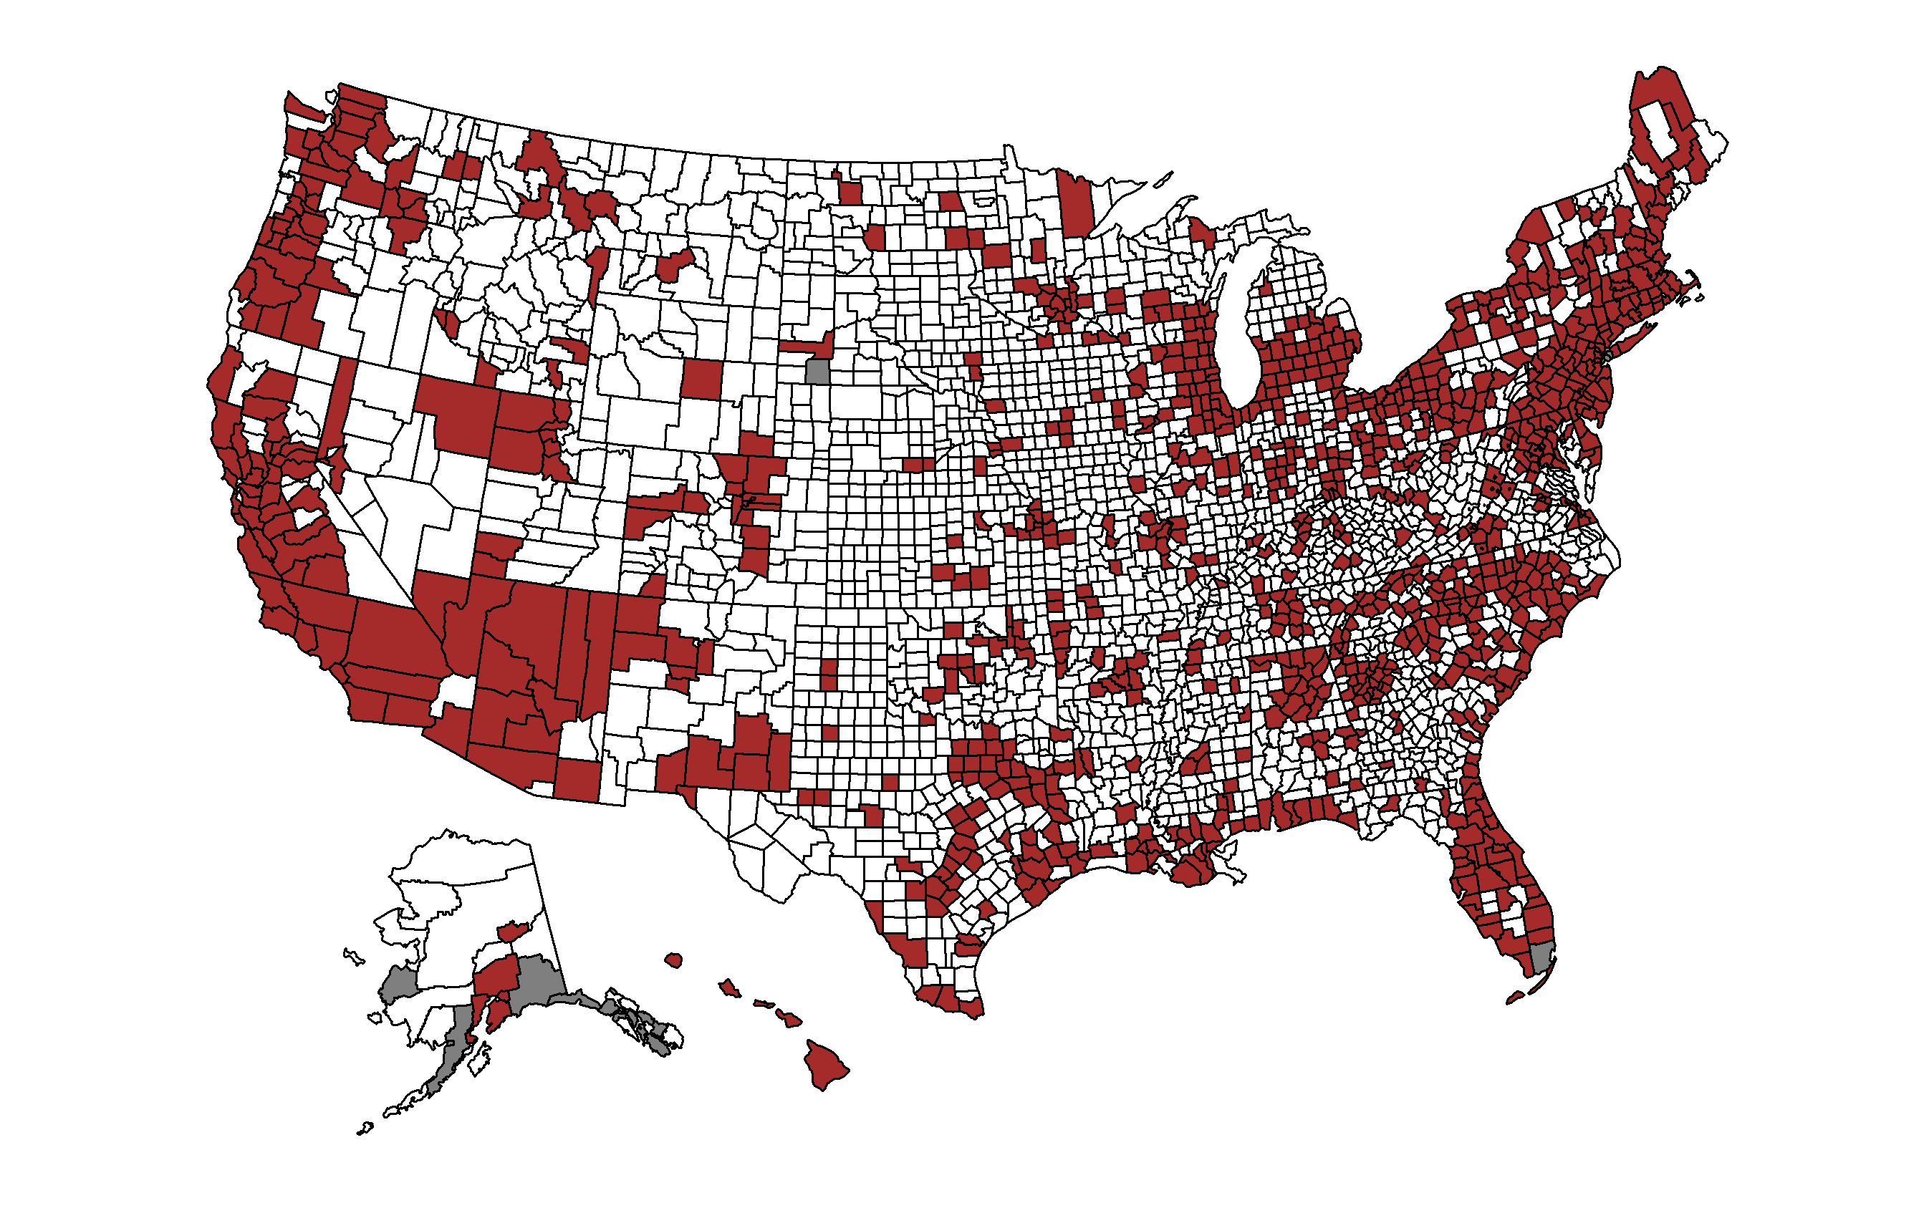
Urban Vs. Rural Classification According to the HRSA

Slide 8
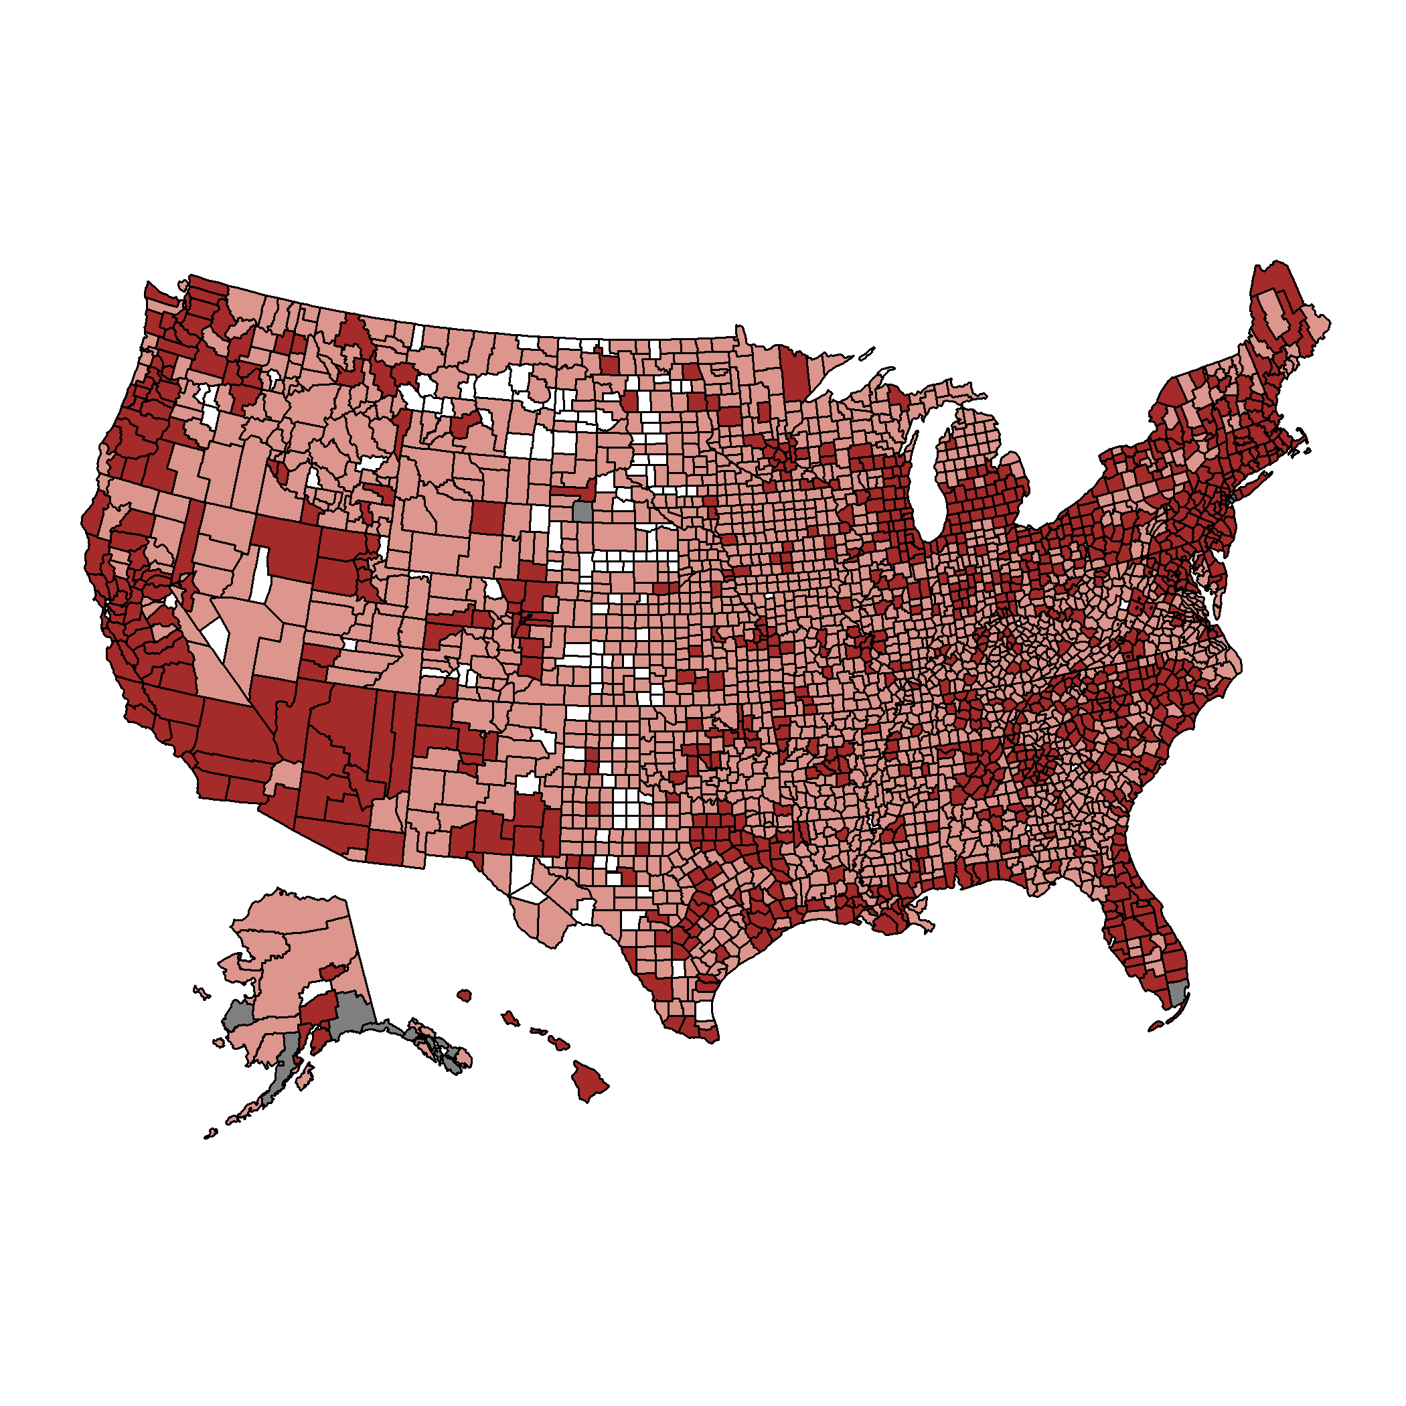
Urban Vs. Rural Classification According to the CDC

Slide 9
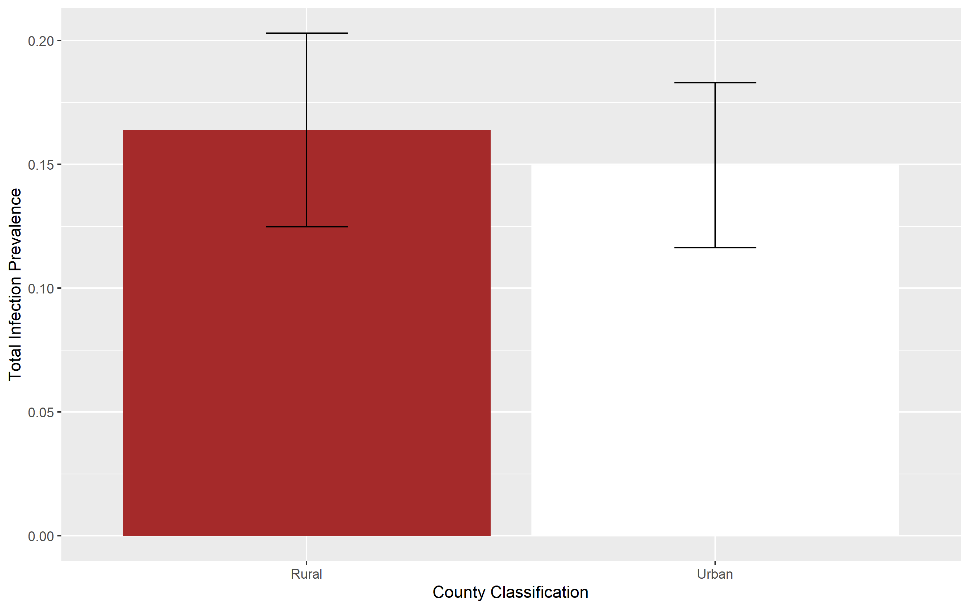
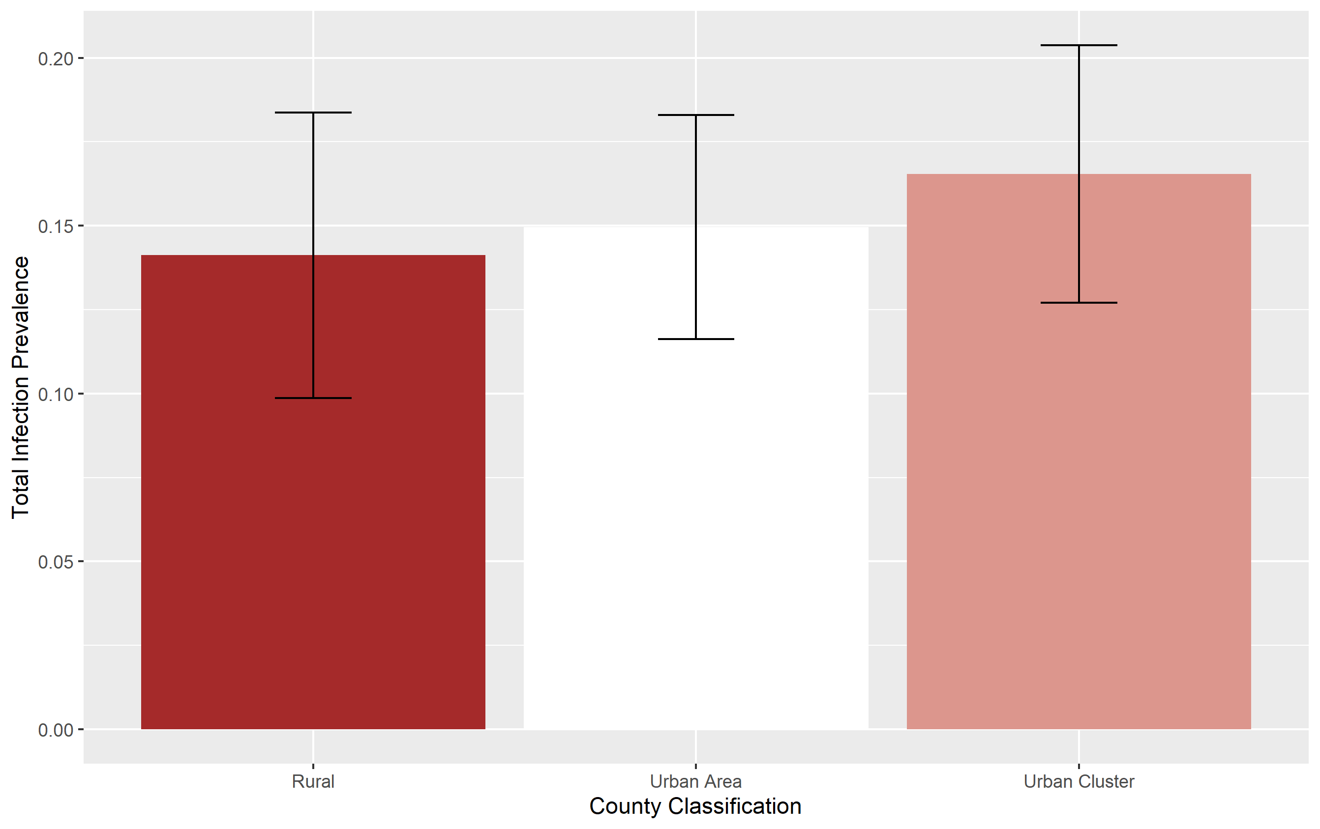

Slide 10
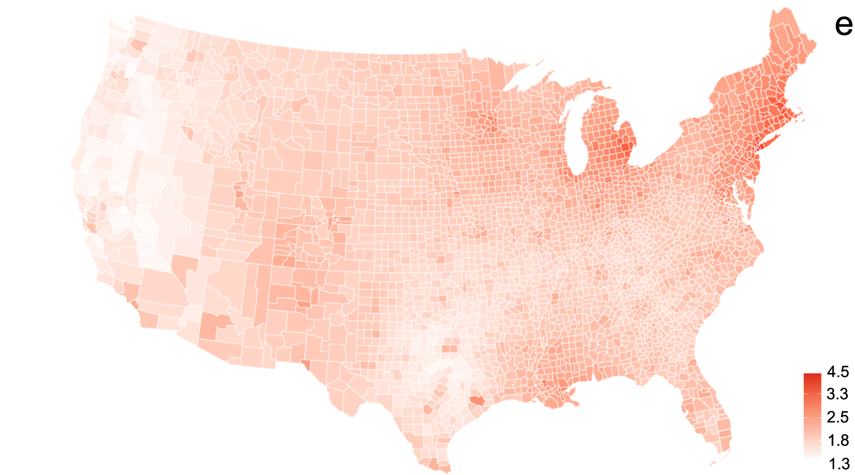

Slide 12
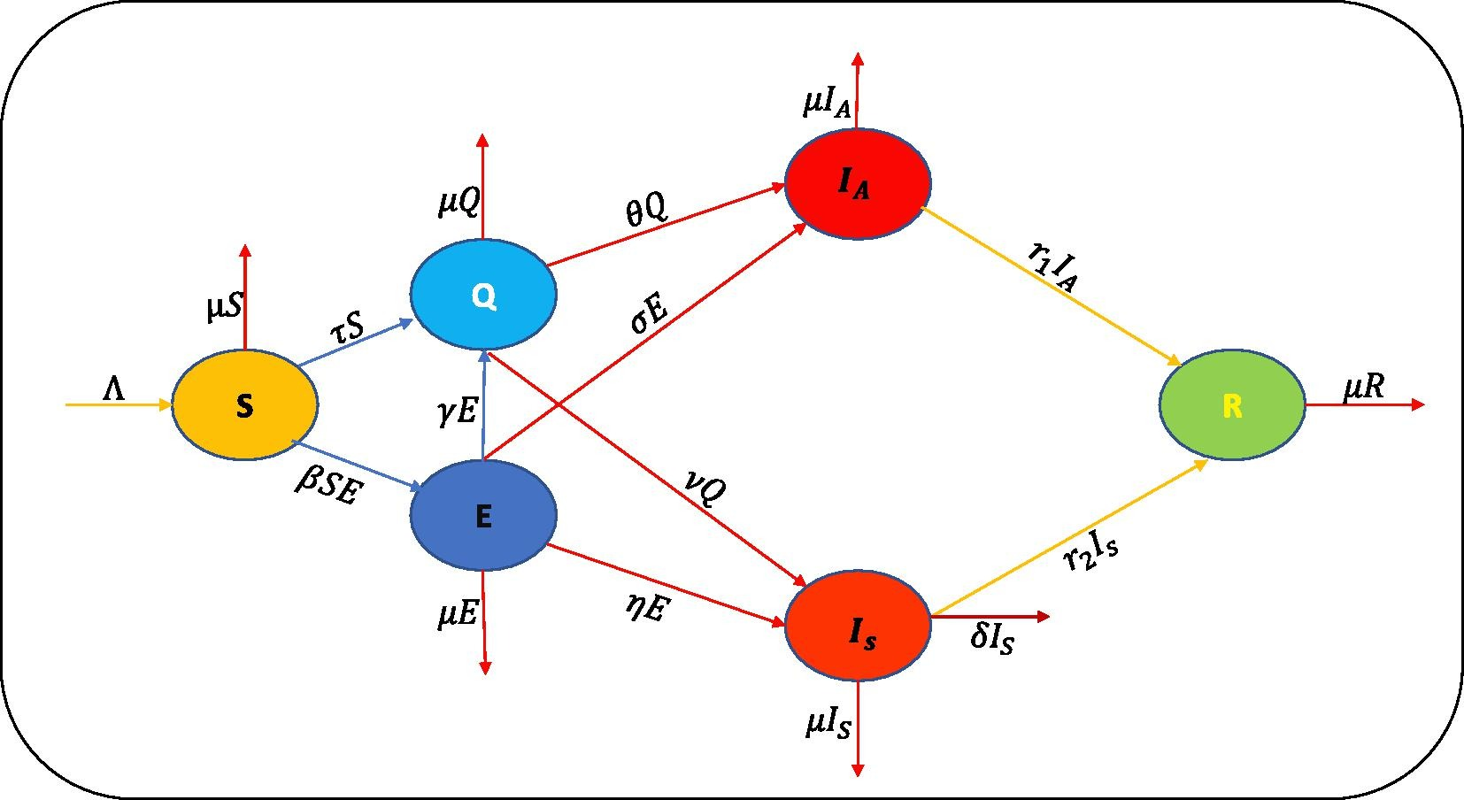
Ahmed et al. 2021

Slide 13
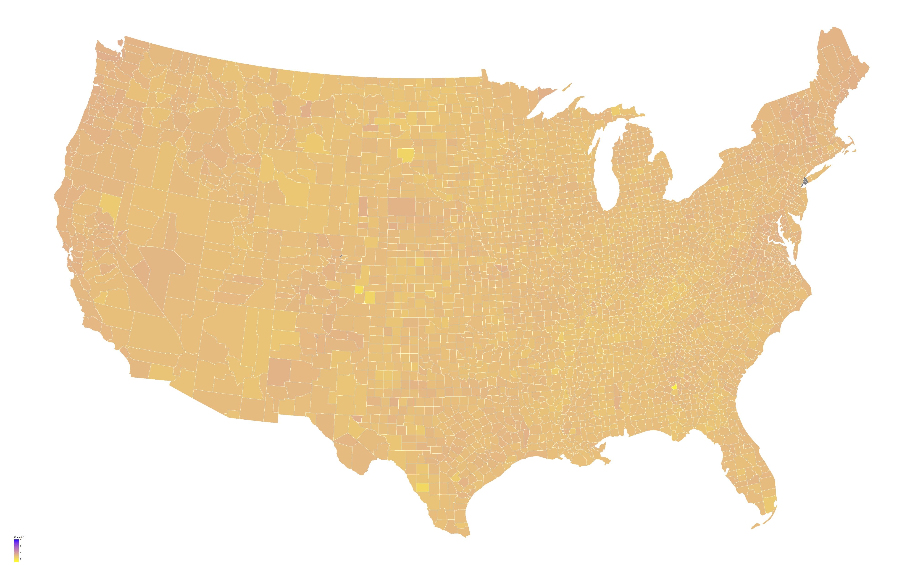
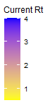
R(t) Values by County

Slide 14
Omicron

Slide 15
